Slide 1

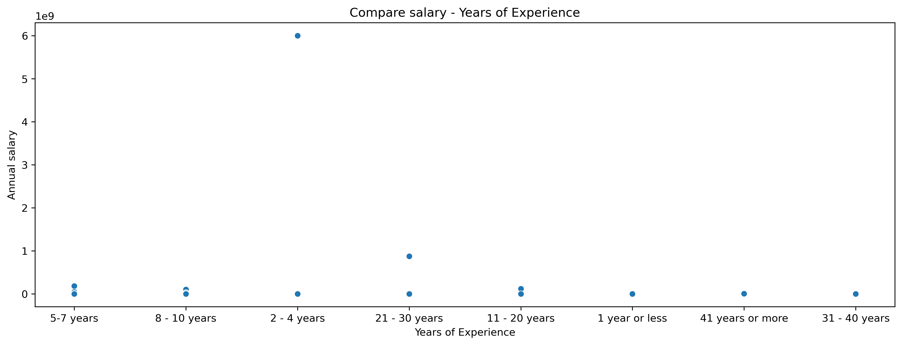
Exploratory Data Analysis and Data Preparation of a Salary Survey Dataset
Andrii Semeniuk
Data Exploration & Preparation
Introduction
Results
The goal of this analysis is to work with the Salary_Survey.csv dataset and get it ready for possible machine learning tasks. The data includes salaries, experience, education, and location of professionals. My main focus is to spot patterns and relationships in the data while making sure it’s clean, consistent, and suitable for modelling.
The dataset had some missing values, which I filled using mean or mode. I found 92 duplicate rows and removed them.
When selecting features, salary turned out to be most strongly related to experience level.
From the visuals, it’s clear that:
Average salary increases with higher experience levels.
Methods
This analysis was done in Python (Jupyter Notebook) using pandas, matplotlib, and seaborn.
I cleaned the data, handled missing values, and checked duplicates.
Then we explored the main statistics and looked at how salary relates to other factors.
Fig. 1 Caption size 24pt Arial and exactly 34pt space between lines
Results
Conclusions
In the EDA, I noticed clear differences in salaries depending on experience level, which highlights the importance of professional context in salary estimation.
Data cleaning made the dataset more reliable, and feature selection kept only the most relevant variables for modelling.
Removing duplicates helped avoid overestimating certain salary levels.
This analysis highlighted the importance of systematic EDA and data cleaning in preparing a dataset.
By handling missing values, outliers, and duplicates, I made the data ready for predictive modelling.
References
Pandas (2018). Python Data Analysis Library. [online] Pydata.org. Available at: https://pandas.pydata.org/.
seaborn (2012). seaborn: statistical data visualization — seaborn 0.9.0 documentation. [online] Pydata.org. Available at: https://seaborn.pydata.org/
Matplotlib (2024). Matplotlib: Python Plotting — Matplotlib 3.1.1 Documentation. [online] Matplotlib.org. Available at: https://matplotlib.org/
Our Dedication.Your Journey.
www.cct.ie

